Slide 1
week 2
lab 1
web programming 2
Dr : Rasha
Eng : Gehad Mustafa

Slide 2

Contents
Arithmetic Operators
Assignment Operators
Comparison Operators
Increment / Decrement Operators
Logical Operators
String Operators
Array Operators

Slide 3
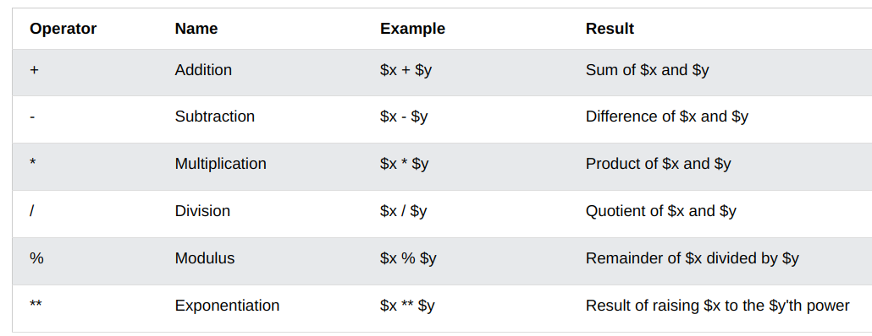
Arithmetic Operators

Slide 4
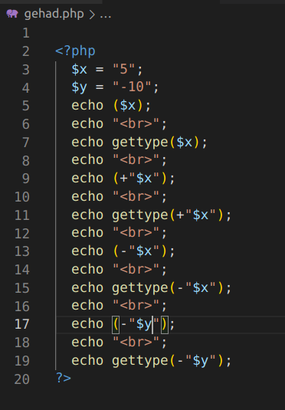
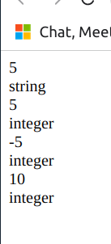

Slide 5
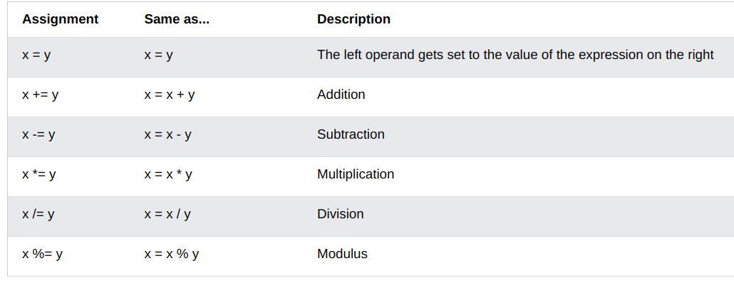
Assignment Operators

Slide 6
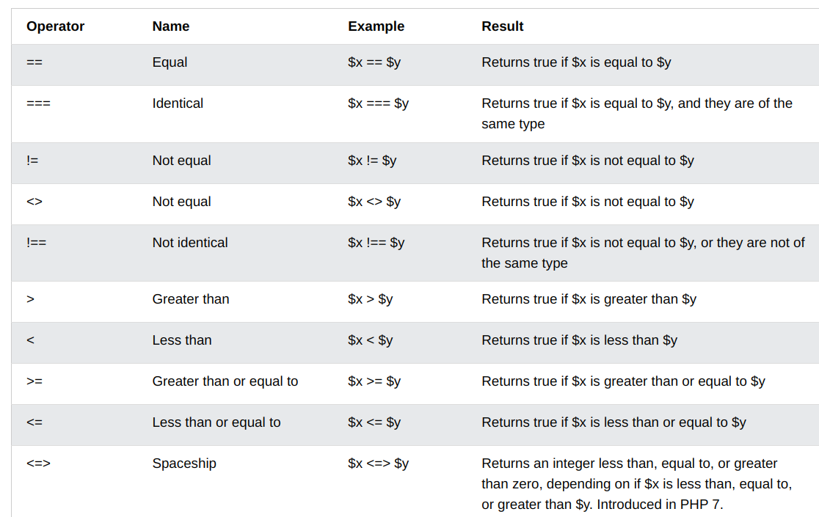
Comparison Operators

Slide 7
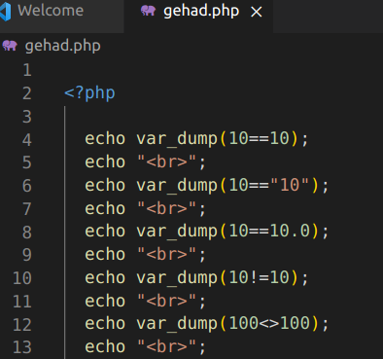
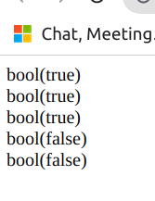
Test Equal
The var_dump() function dumps information about one or more variables. The information holds type and value of the variable(s).

Slide 8
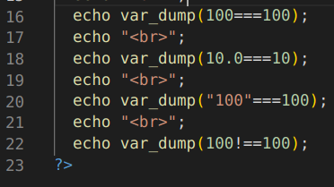
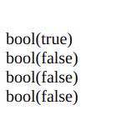
Test Identical

Slide 9
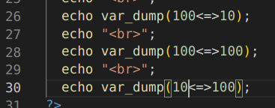
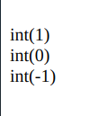
Spaceship

Slide 10
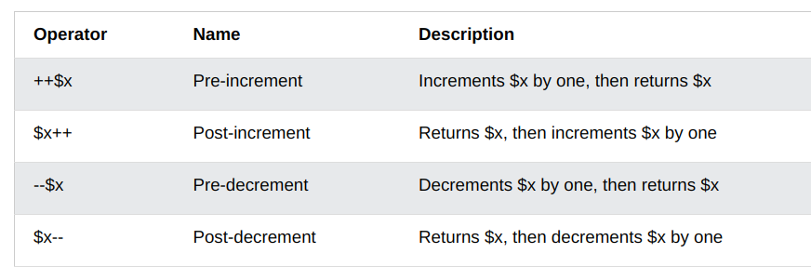
Increment / Decrement Operators

Slide 11
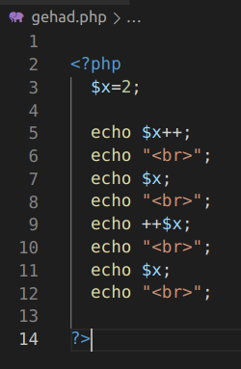
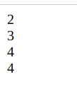
Increment / Decrement Operators

Slide 12
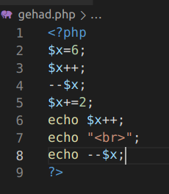
Try This

Slide 13
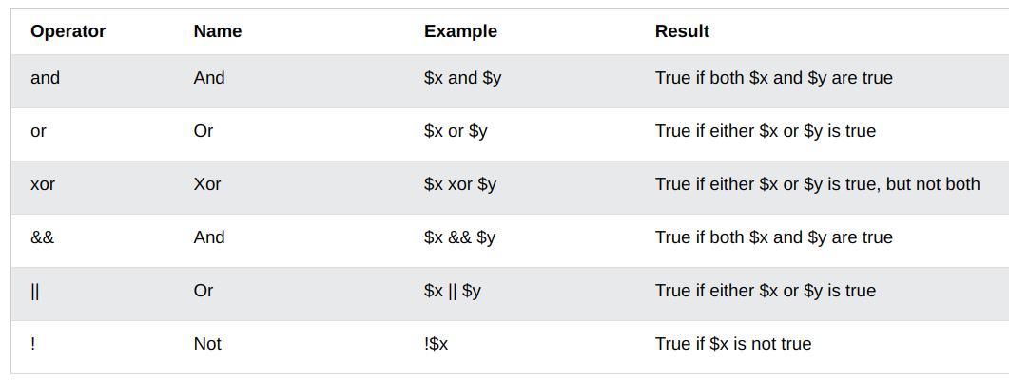
Logical Operators

Slide 14
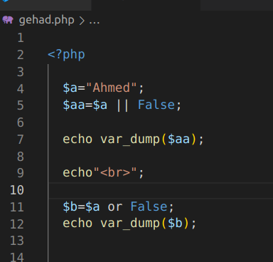
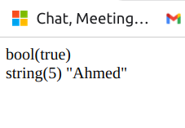
Logical Operators

Slide 15
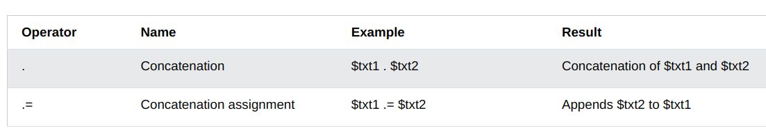
String Operators

Slide 16
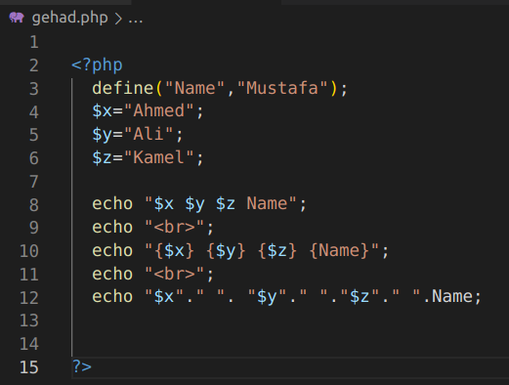
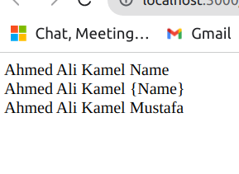
String Operators

Slide 17
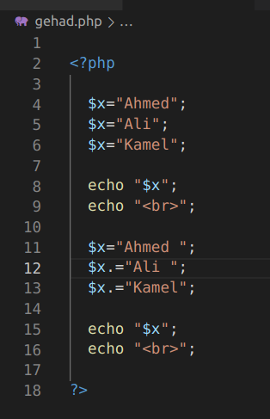
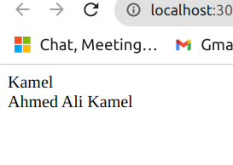
String Operators

Slide 18
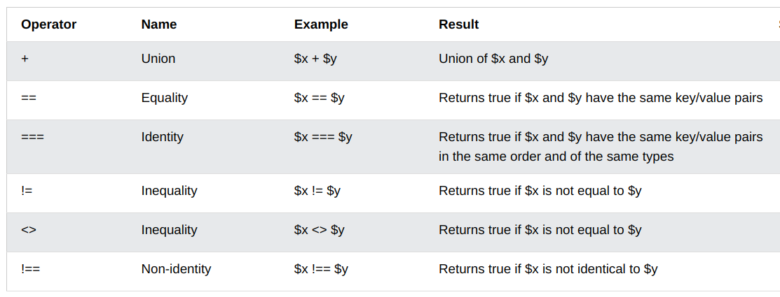
Array Operators

Slide 19
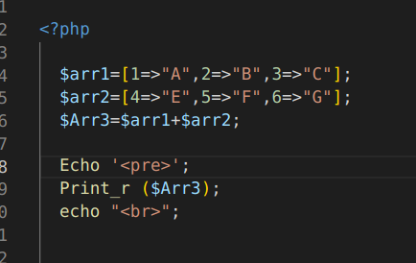
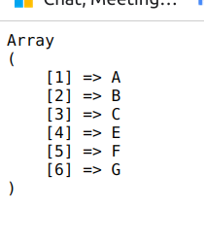
Union

Slide 20
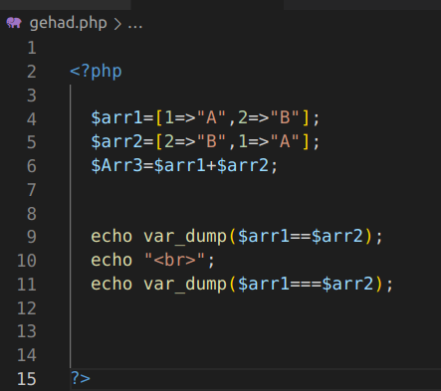
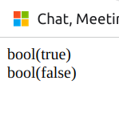
Array Operators

Slide 21
Conditional Statements
if statement - executes some code if one condition is true
if...else statement - executes some code if a condition is true and another code if that condition is false
if...elseif...else statement - executes different codes for more than two conditions
switch statement - selects one of many blocks of code to be executed

Slide 22
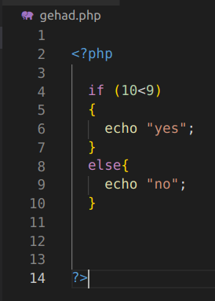

The if Statement
if (condition) { code to be executed if condition is true; }

Slide 23
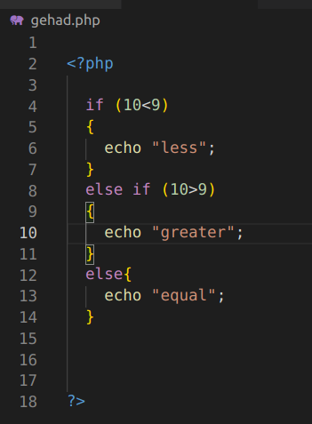
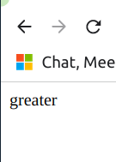
else if

Slide 24
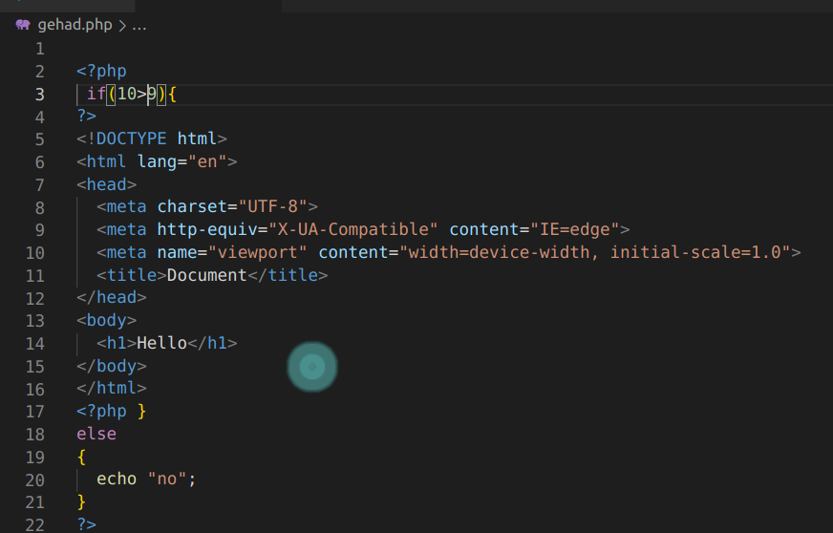
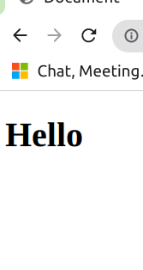
If

Slide 25
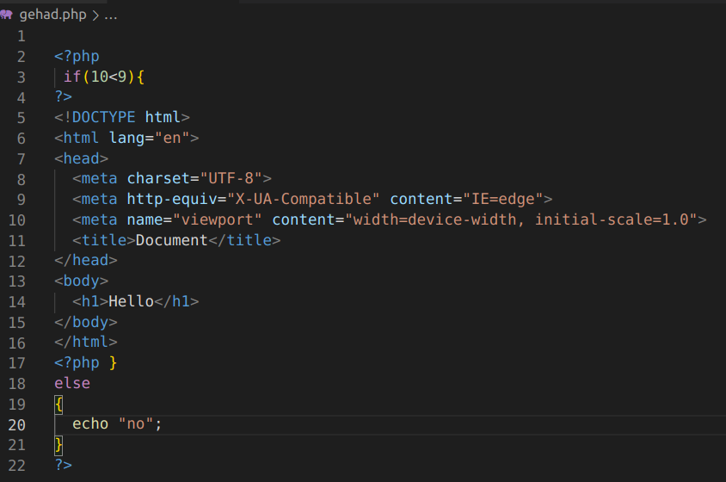

If

Slide 26
Try This
write php code to print the max of three numbers.
write a php code to calculate the grades of a student if :
mark>= 90 → print “A”
mark >= 70 → print “B”
mark >= 50 → print “C”
mark < 50 → print “F”

Slide 27
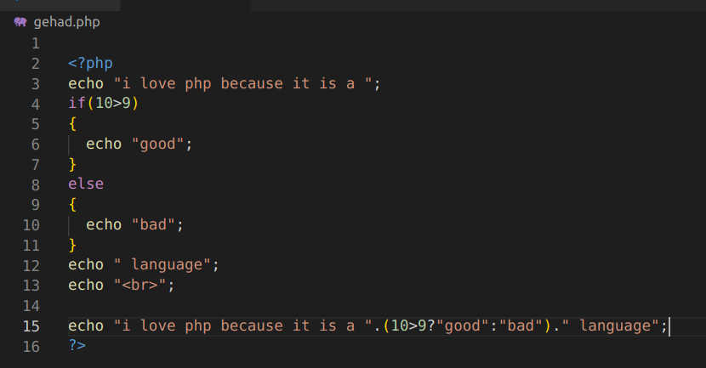
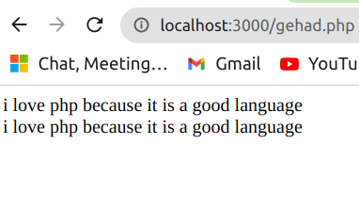
ternary Operators

Slide 28
Switch
switch (n) {
case label1:
code to be executed if n=label1;
break;
case label2:
code to be executed if n=label2;
break;
case label3:
code to be executed if n=label3;
break;
...
default:
code to be executed if n is different from all labels;
}

Slide 29
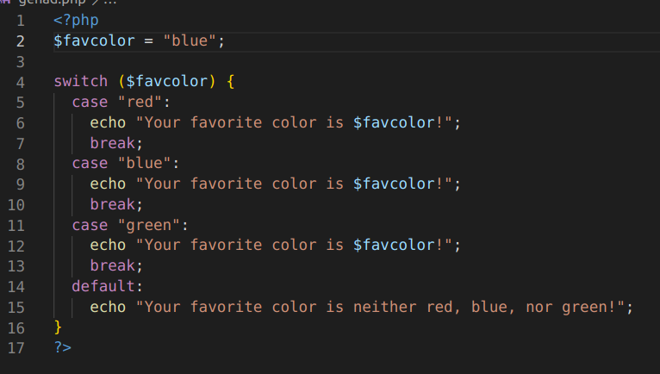
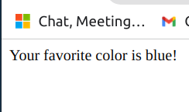
Switch

Slide 30
Try This
write PHP code to simulate a calculator by using Switch.
inputs 4( + or - or * or / )1.
output 5 or 3 or 4 or 4.

Slide 31
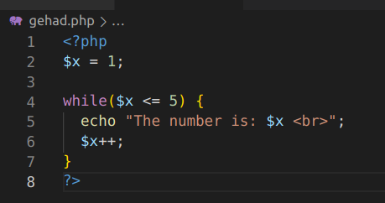
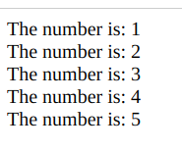
While
while (condition is true) { code to be executed}

Slide 32
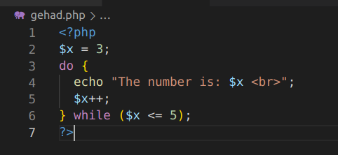
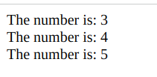
Do While
do {
code to be executed;
} while (condition is true);

Slide 33
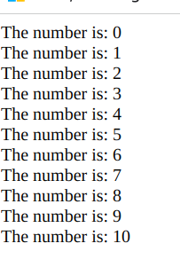
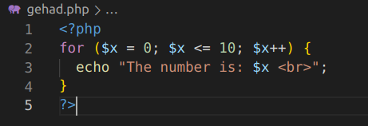
For
for (init counter; test counter; increment counter) {
code to be executed for each iteration; }

Slide 34

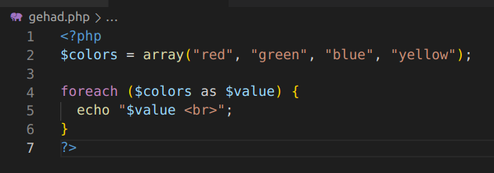
foreach
foreach ($array as $value) {
code to be executed;
}

Slide 35
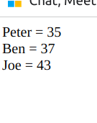
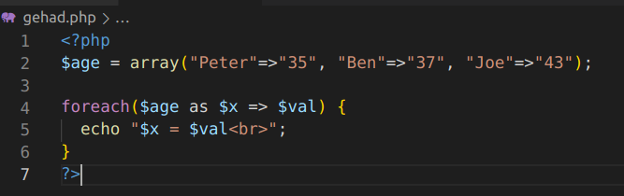
foreach
foreach($Array as $Key => $Value) {
code to be executed;}

Slide 36
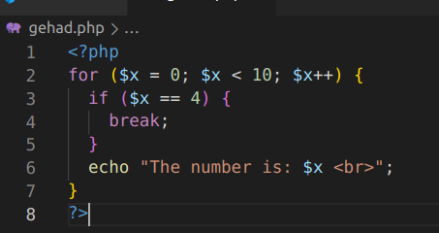
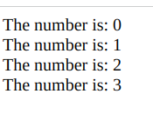
PHP Break

Slide 37
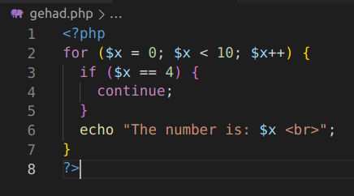

PHP Continue

Slide 38

Try
write php code to print this output

Slide 39

Answer

